Slide 1


Gujarat University Department of Computer Science MCA Semester 6 Project
Lead Management System
Yash Palsanawala(32)
Vivek Vyas(30)
Project Guide(Internal):
Dr . Bhumika Shah
Project Guide(External):
Mr Ritesh Gandhi(C.T.O Pedagogy)

Slide 2
Agenda AA Pachi change kari desu
Company Details
Project Profile
Technologies used
Project Description
Timeline
Modules
Functional Requirements
System Analysis
Use case
Activity
System Design
Class Diagram
Sequence Diagram
System Implementation
Test Cases
Challenges Faced
Future Work

Slide 3
Company Details
Name :- Pedagogy.
Address:- B-4, Himmatlal Park, Near Azad Society
Satellite, Ahmedabad-380015
Pedagogy, founded in 2016 focuses on education landscape.
Pedagogy offers subscription to the popular books & digital courses for various Entrance exams from Trusted Publishers & Coaching.
Know more: https://www.pedagogy.study/about-us

Slide 4
Project Profile
Title- Lead Management and report generation System
Aim- To provide a platform for company to manage and analyse student leads and generate reports.
Developed by- Yash Palsanawala and Vivek Vyas.
Developed for- Pedagogy.

Slide 5
Technologies USed
LANGUAGES
ANGULAR
SPRINGBOOT
JAVASCRIPT
HTML5
CSS
SOFTWARES
VISUAL CODE IDE
ECLIPSE IDE
XAMPP
POSTMAN

Slide 6
Team Members
GUIDES
Ritesh Gandhi(Co-Founder)
Pooja Pawar(Frontend Head)
Manan Shah(Tech Lead)
DEVELOPERS
Yash Palsanawala
Vivek Vyas

Slide 7
Project Description
To provide a platform for company to manage and analyse student leads and generate reports for sales and marketing team.
Objective
To help company grow their business by helping them to manage and analyse student leads.

Slide 8
End USErs Client
Partner Institutes
Teachers
Admin
Multiple coaching institutes

Slide 9
Hardware requirement Software requirement
RAM : 4 GB [At least]
Internal Storage : As per the requirement to store uploaded files
Operating System [any]
Web Browser

Slide 10
Functional requirments
Any new student who signs up on the institute portal or through white labeled app will be shown here.
There are 3 stages of lead - (a) Active (b) In Progress (c) Closed
Closed stage will have 2 options - (c1) Closed Successful (c2) Closed Unsuccessful.
Each lead stage will also have a date when a lead entered then stage. We will use this date for reports and analysis .
Partner will move lead from one stage to other in all cases except one - where a student registers and enrolls in a course offered by Institute or buys Infinity Pass
A lead can be moved to any state from any other state without any restriction.
There will be a notes sections where Partner will be able to append notes as he interacts with the lead.
System will automatically append the date in the notes where lead changes stage - Active to In progress; In progress to Closed.
When a student’s registers and enrolls in a course - we move him into Closed - Closed Successful automatically

Slide 11
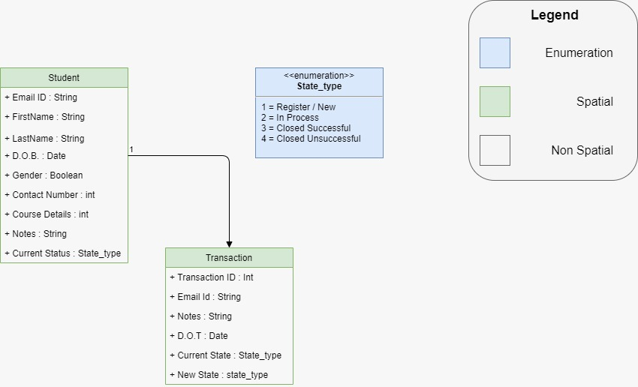
Class diagram

Slide 12
Task executed till date
Learned Spring boot for server side stateless API creation.
Learned to use postmen tool which is industry wide used for API testing
Learned vanilla javascript,html5,angular js for frontend development of web application.
Developed a CRUD based student application for creating , listing ,updating and deleting student details
In the above mentioned application we have also implemented the concept of authorization and authentication by generating token from server side .

Slide 13
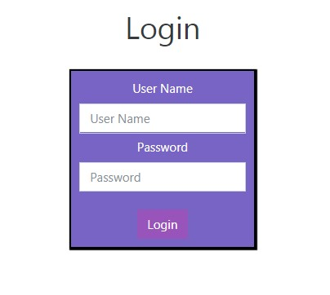
Login pagE

Slide 14
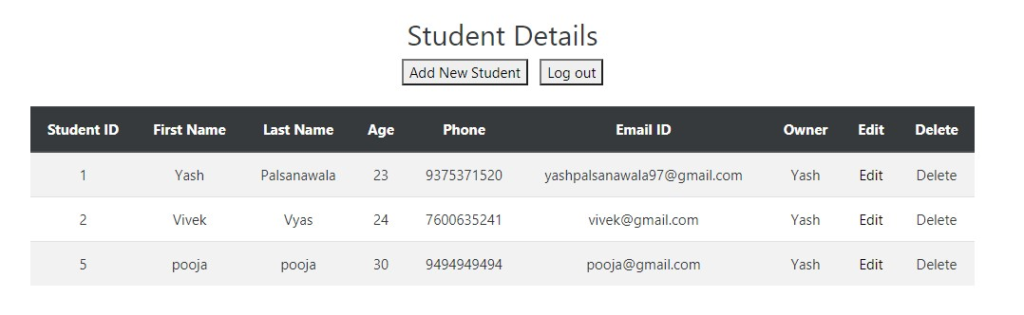
Home pagE

Slide 15
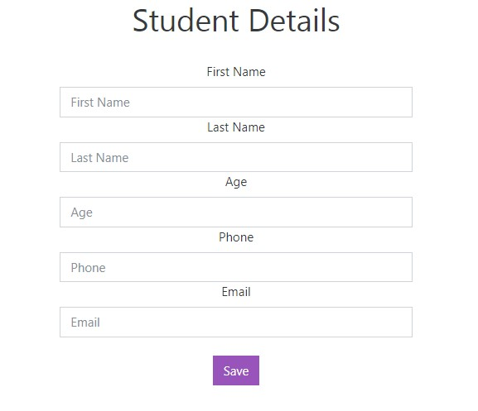
Add new record

Slide 16
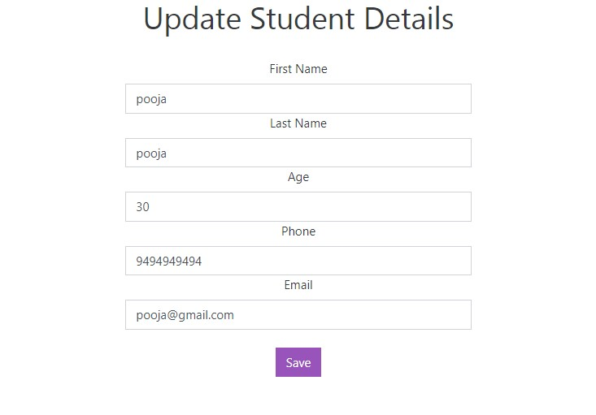
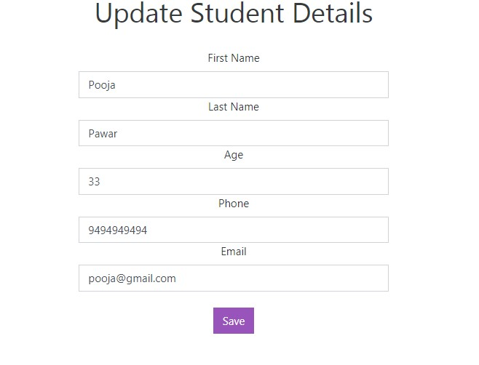
Edit record

Slide 17
Future Work
Manage Courses
Manage Students
Manage Mobile Application (Android and IOS)

Slide 18
Thank You

